Slide 1

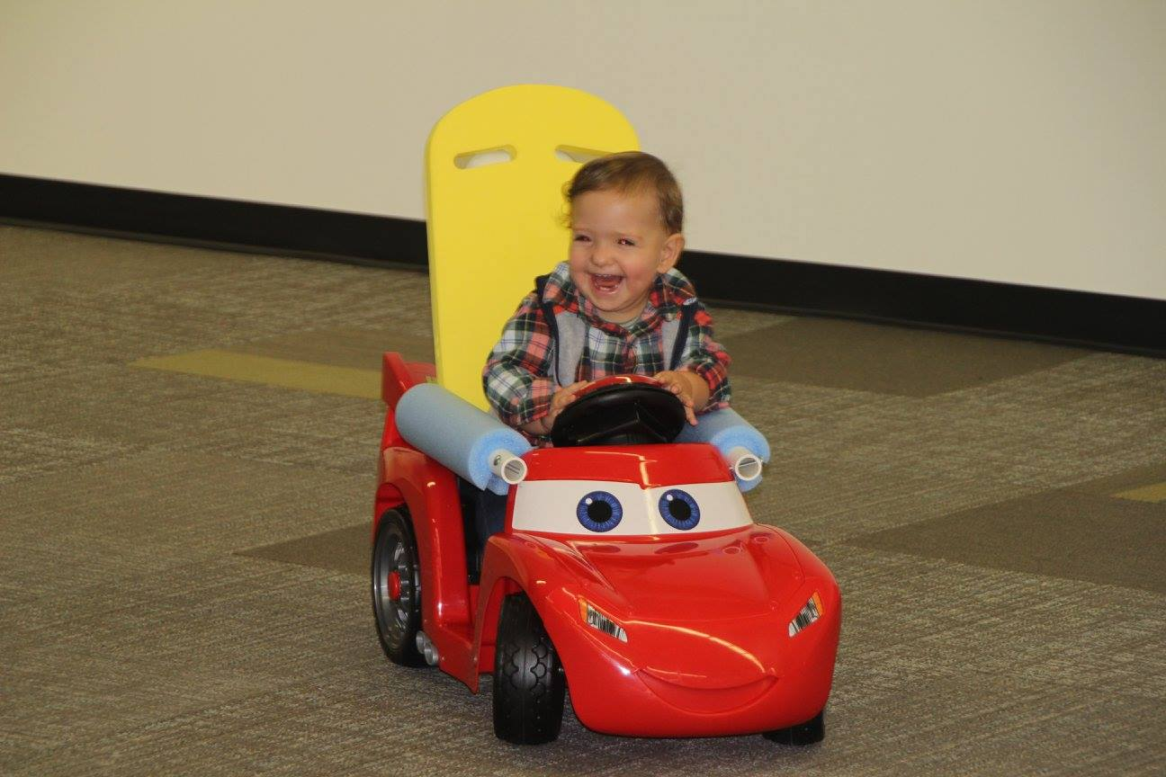
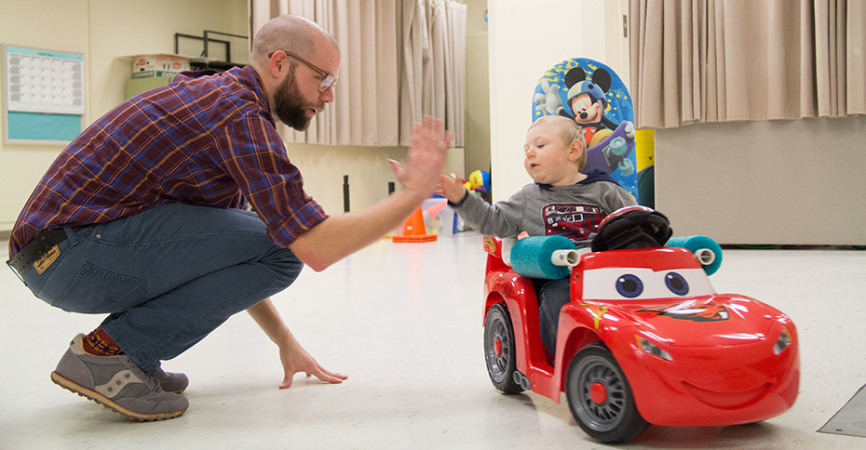


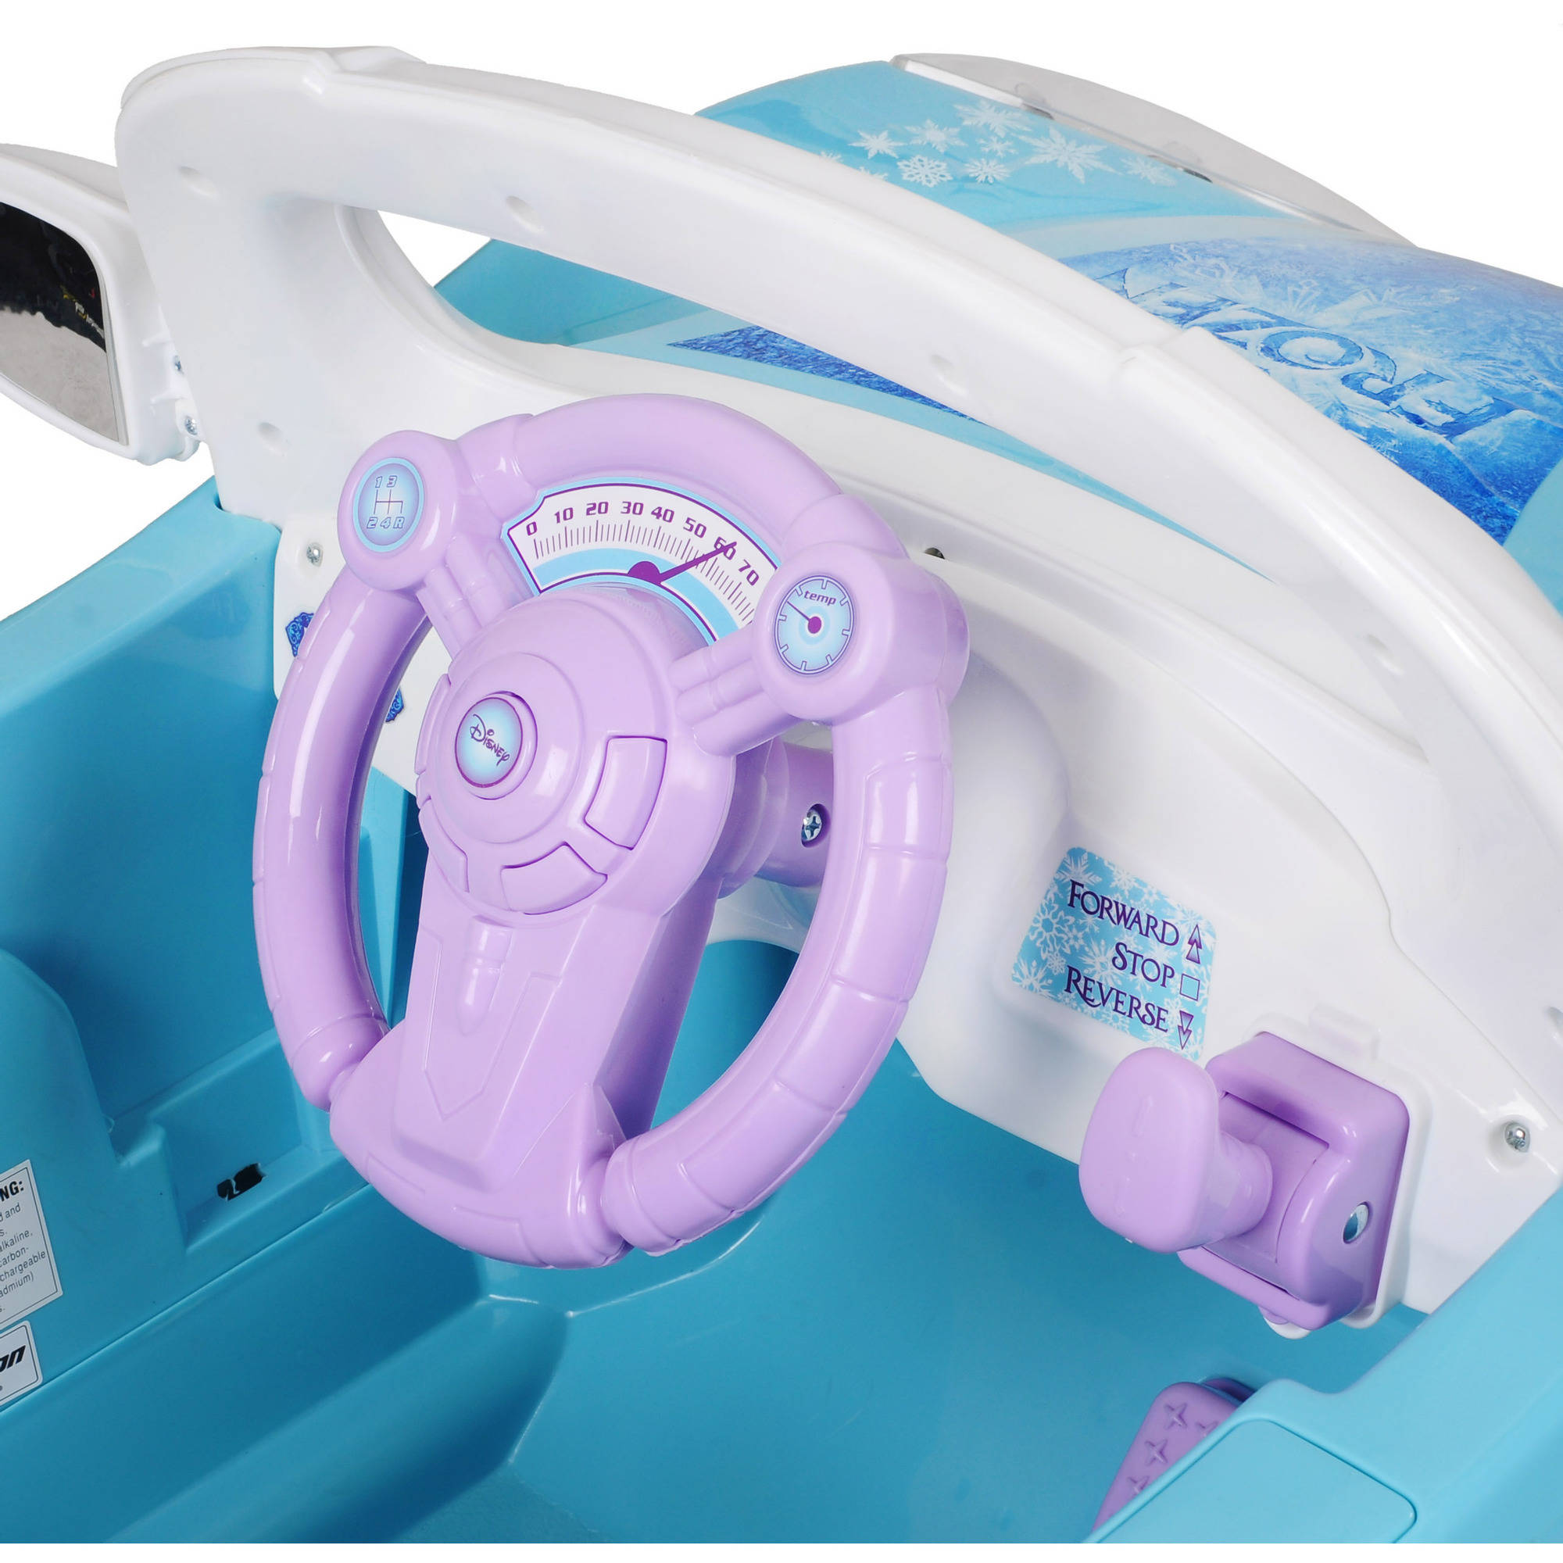
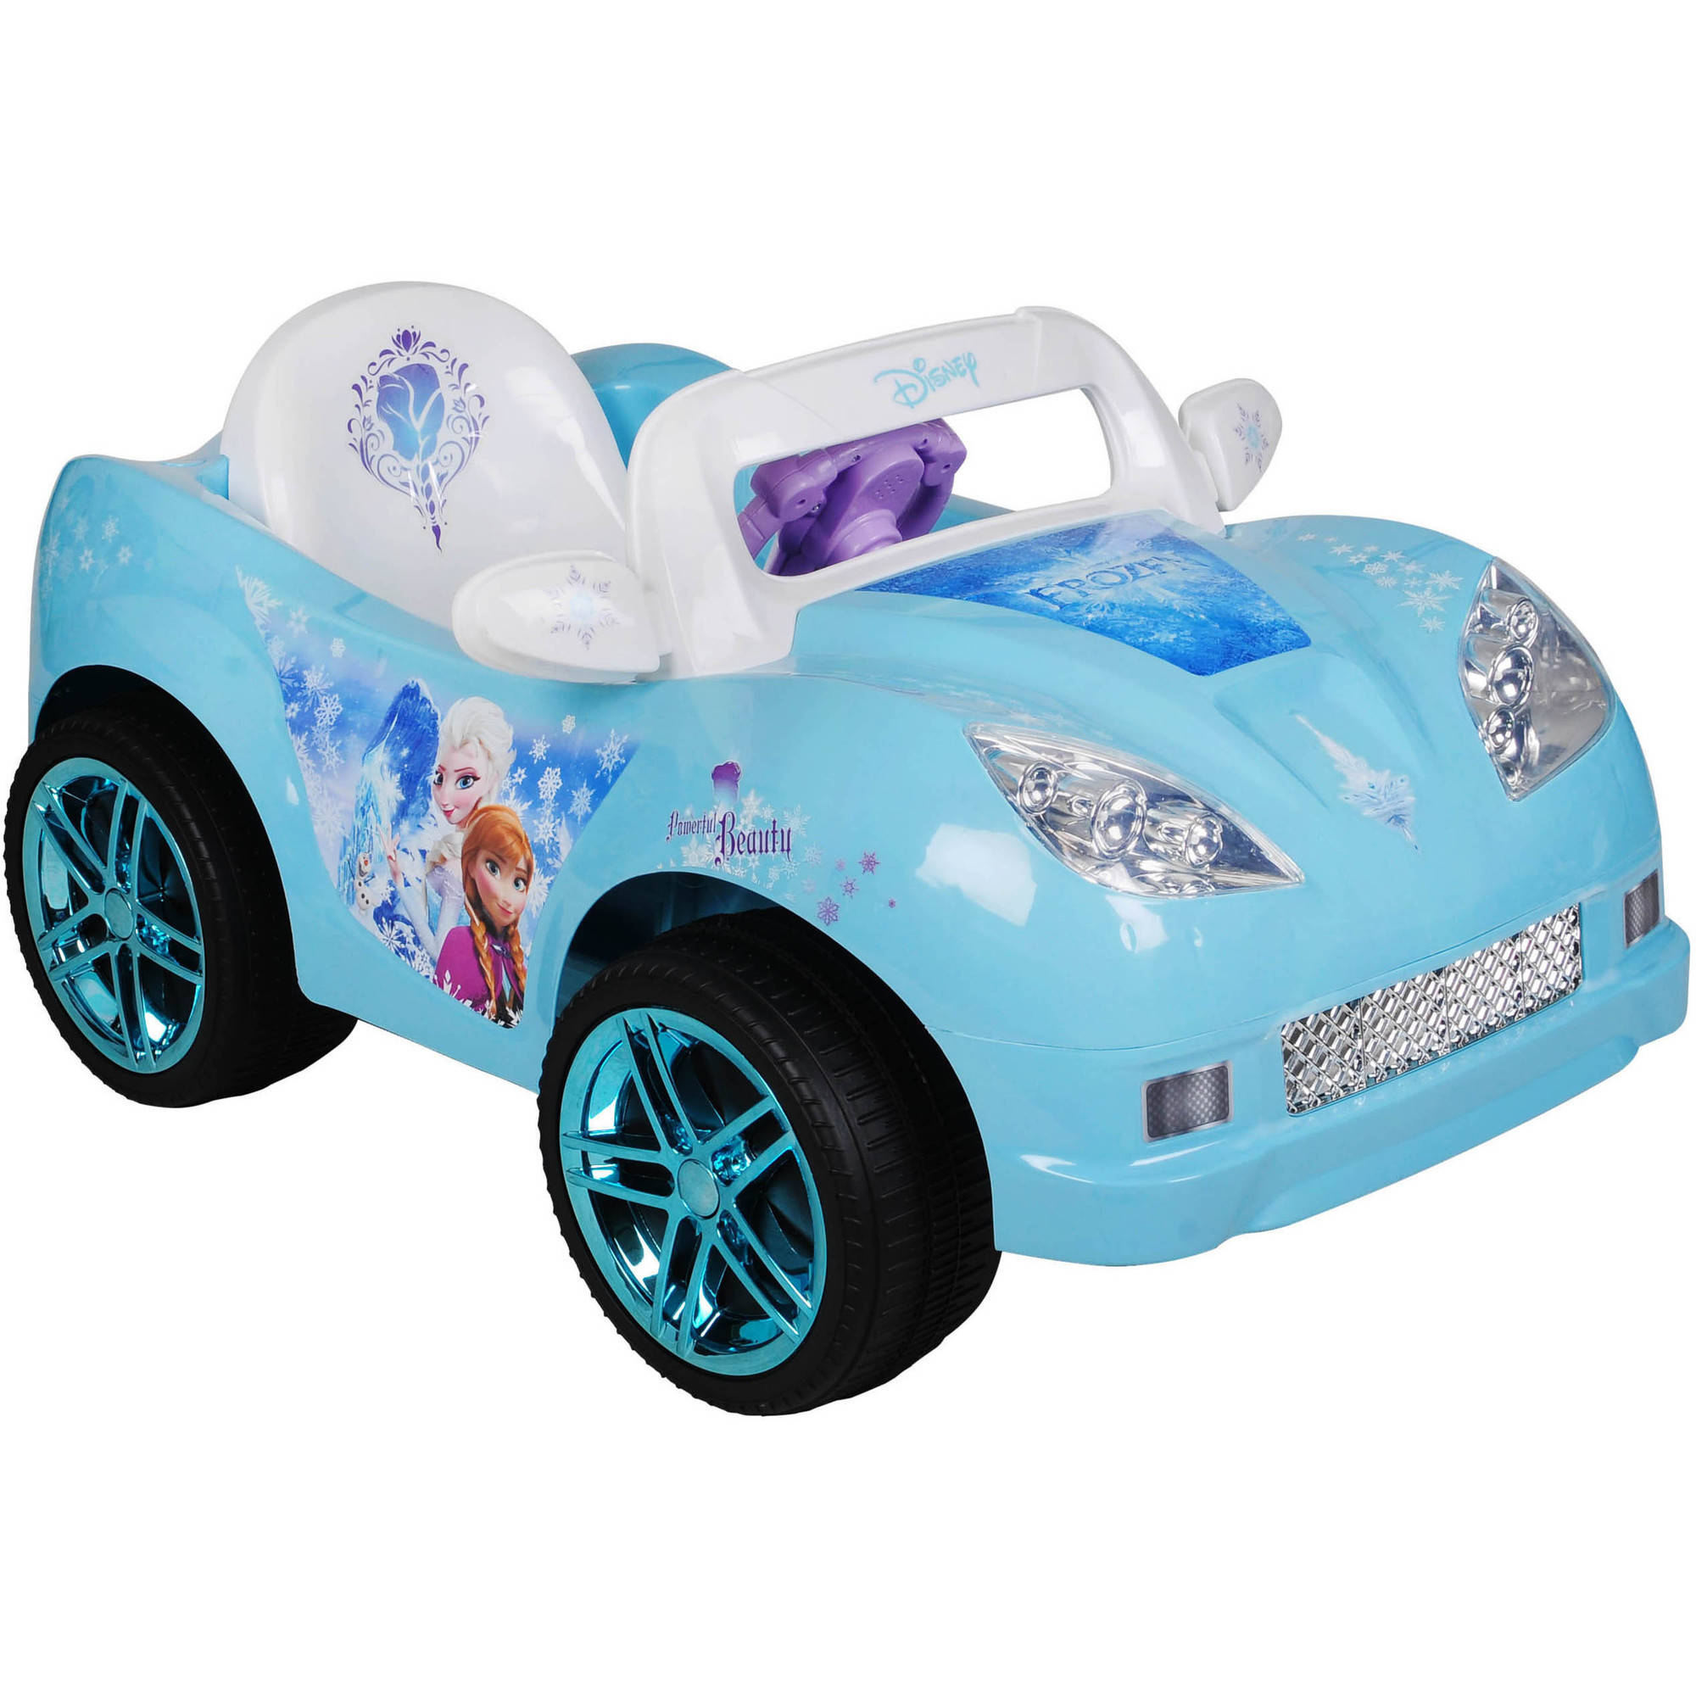




Go Baby Go – Safe Wheels
Colin Eckhoff, Kush Tekriwal, Hongjian Jiang
The Challenge
Children need more accessible steering options for ride-on cars, which enables movement because every child deserves to move autonomously.
Among toddlers aged 3 and under with mobility impairments, there exists minimal assisted-mobility solutions. Go Baby Go addresses this discrepancy in disability service by modifying toy ride-on cars to make them more accessible and ergonomic. Our primary goal with Go Baby Go is to reduce, as much as possible, the factorization of strength and dexterity into operating the car.
Design Idea
Accessible for Babies
Replace steering wheel with joystick
- Contact-based
- Colorful to encourage
engagement
Add power steering
Adjustable joystick position
Minimal strength and dexterity
required
Safety
Seat belt
Emergency stop button on the back of the car
Roll cage made of PVC pipes and foam
Adjustable seating
Smooth turning operation
Designed for Babies
More affordable than wheelchairs
More user-friendly
Fun and motivating
Encourages self-directed exploration and socialization
Ease of Assembly
No specific skills required to build a prototype
Minimal components
- No need for
microcontroller or
advanced circuitry
3D Printing for fabrication of mechanical components
Visit Go Baby Go workshop
Prepare budget and order components
Build a working model
Test prototype with children
Mechanical aspect of power steering, possibility of using a 3D printer
Position adjustability of joystick
Next
We need your feedback
Acknowledgements
Dr. Kat Steele, Dr. Heather Feldner, Dr. Shawn Israel, Ms. Brianna Goodwin.
We thank the Mathers Fund to Empower and Improve Human Ability for their on-going support of HuskyADAPT

